Slide 1



FFT
Point-by-point
Multiplication
IFFT
FFT
Frequency-domain Convolution

Slide 2

FFT
Point-by-point
Multiplication
IFFT
FFT
Frequency-domain Convolution

Slide 3





1 Batch
5 Batches

Slide 4
12672 sample Packet or Batch
Preamble
ASM
Data
1 Set of 3104 Batches
Batch 0
Batch 1
Batch 2
Batch 3101
Batch 3102
Batch 3103

Slide 5






Fill Vector
cuSolverSp
Frequency-domain Convolution
Fill CRS
Matrix
Auto-
correlation

Slide 6



Fill Vector
cuSolverSp
Frequency-domain Convolution
Fill CRS
Matrix
Auto-
correlation

Slide 7





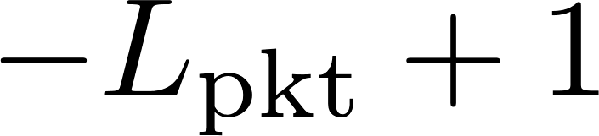




Slide 8






Frequency-domain Convolution
Multiply
Frequency-domain Convolution
Steepest Descent
Conv
Conjugate Time Reversal
Frequency-domain Convolution

Slide 9
FFT
Point-to-point
Multiplication & Division
IFFT
FFT

Slide 10

FFT
Point-to-point
Multiplication & Division
IFFT
FFT

Slide 11
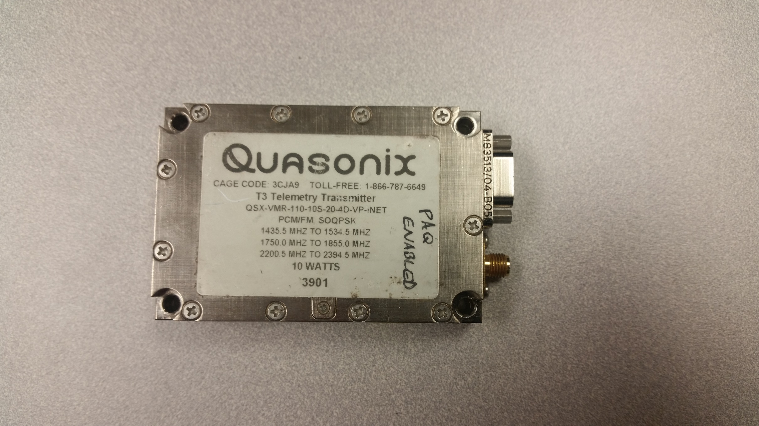
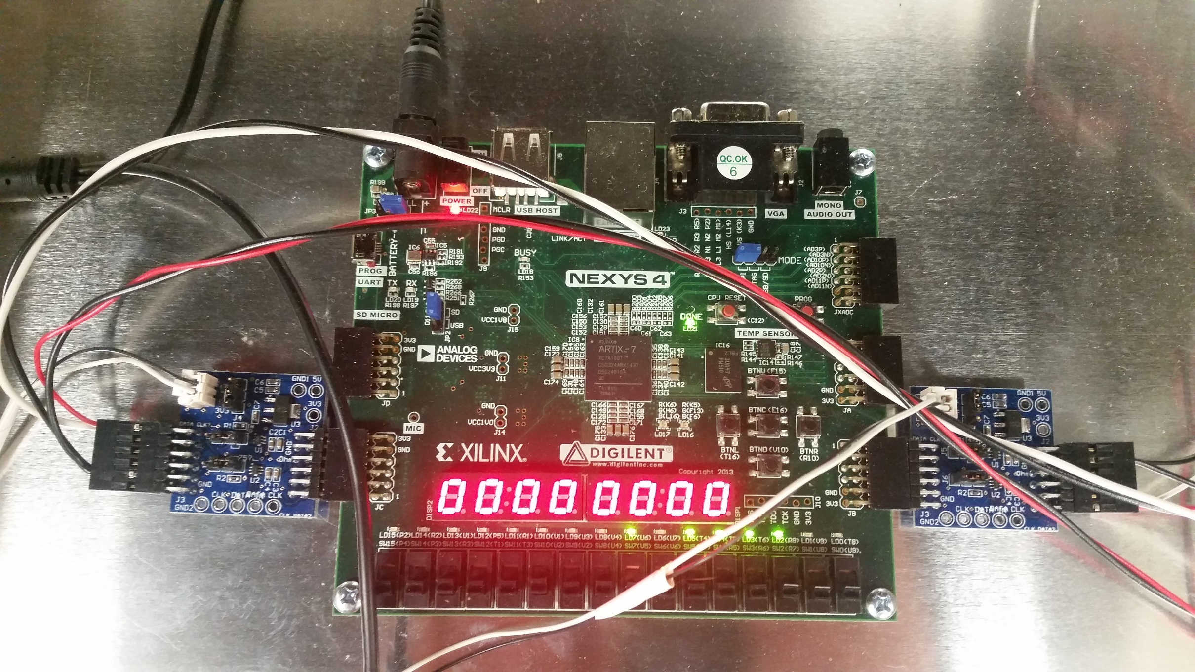
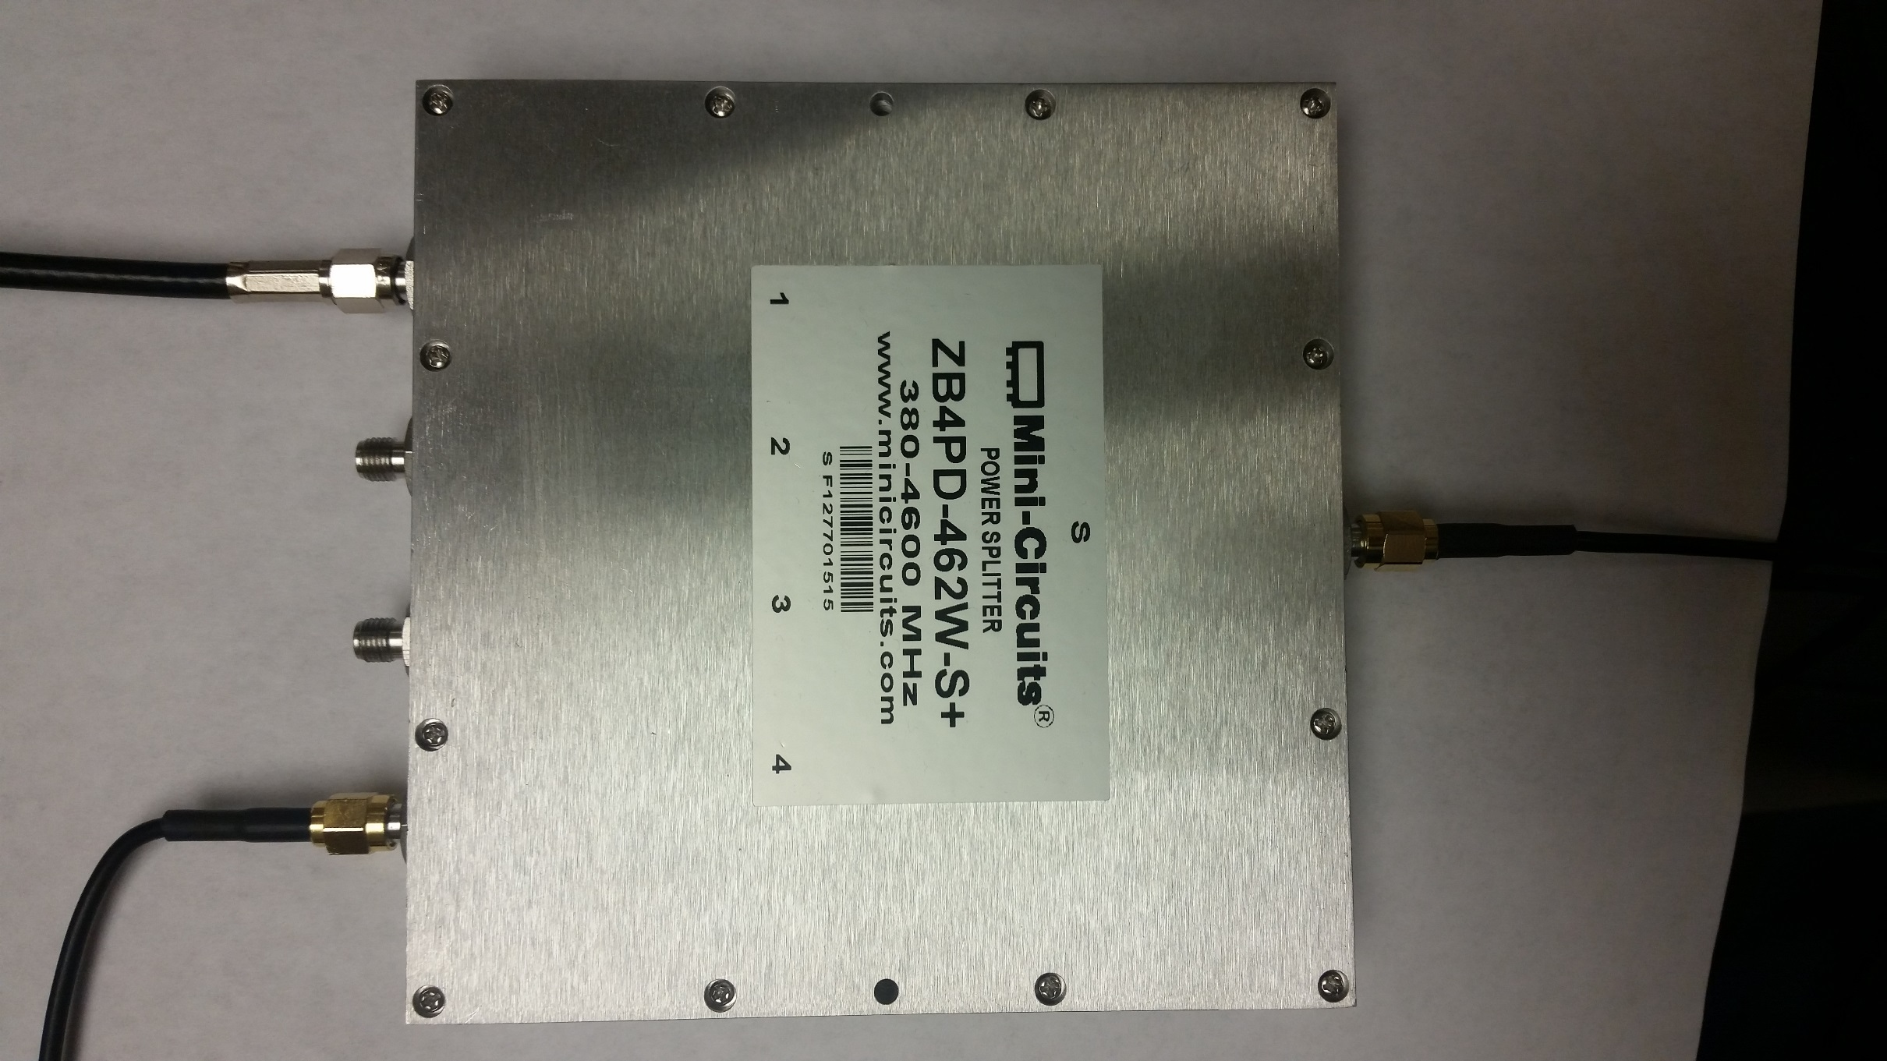
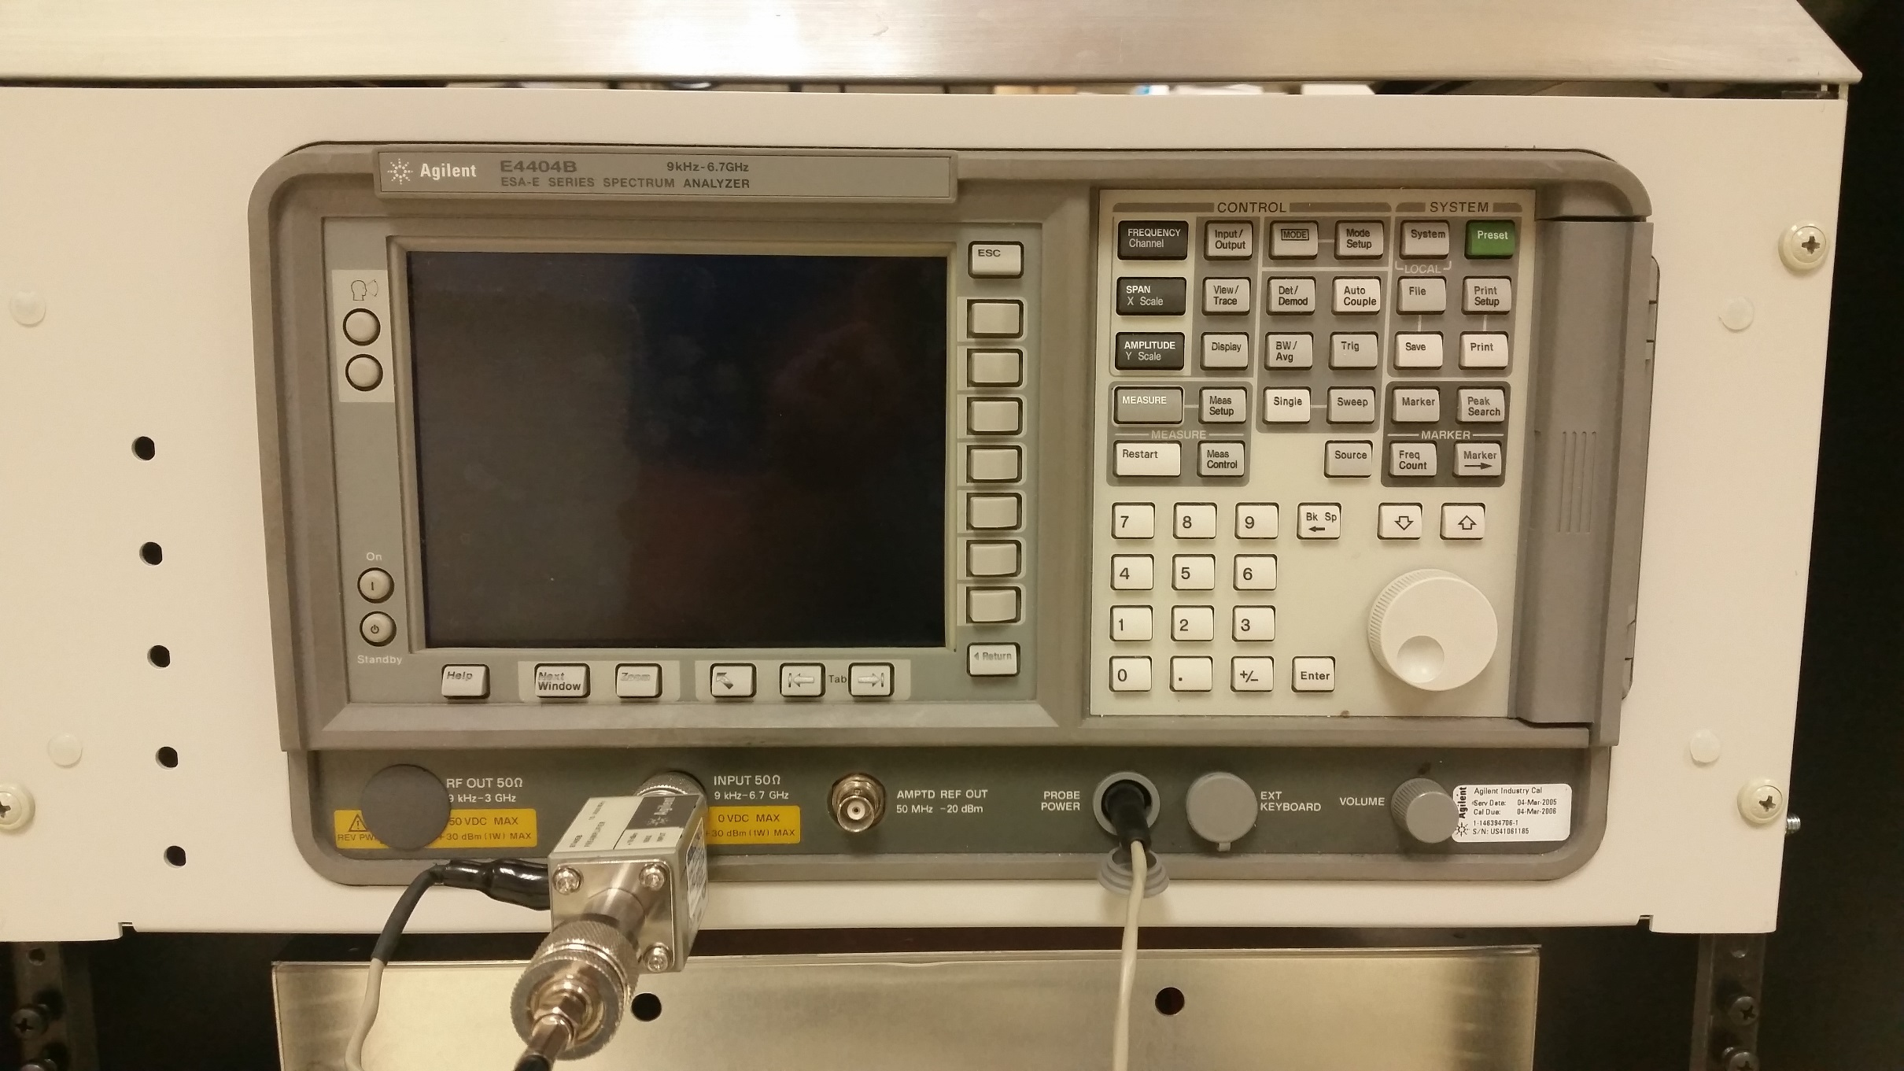
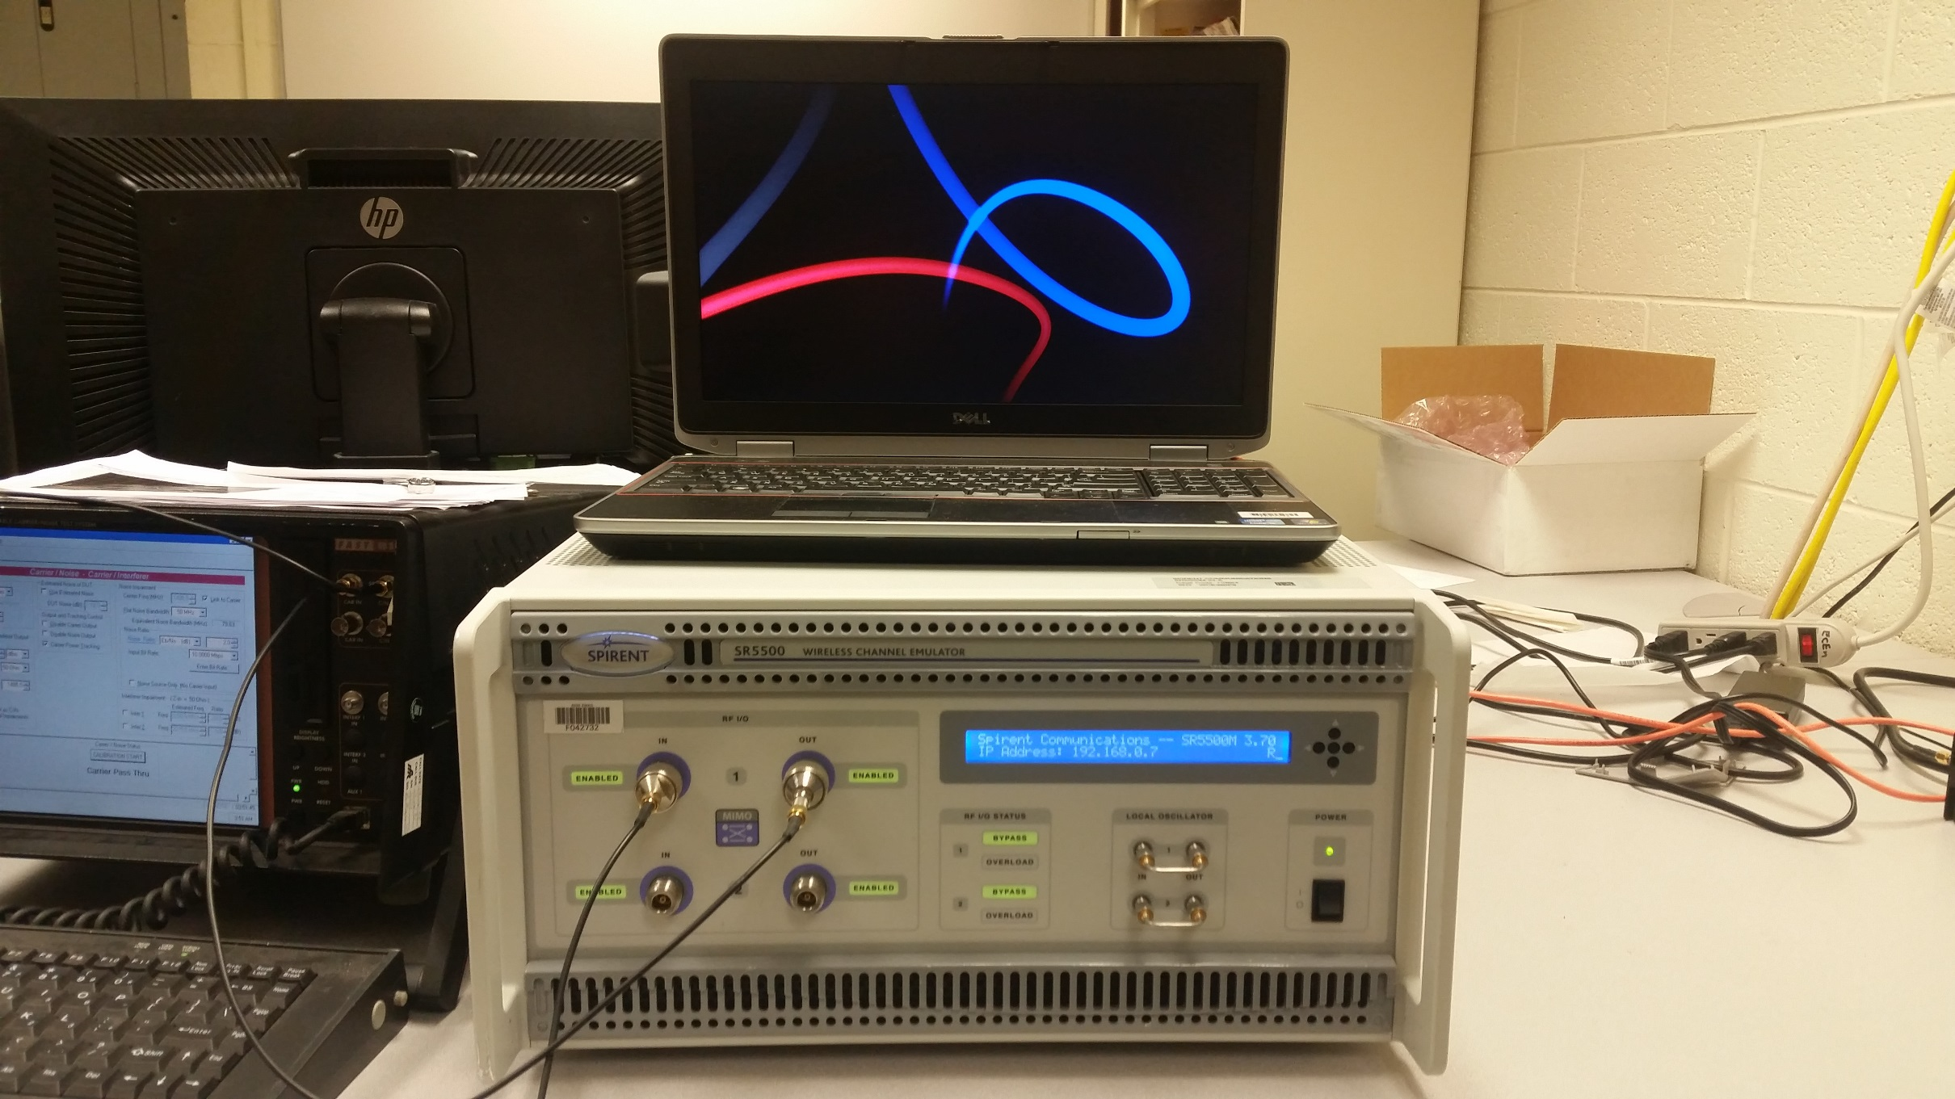
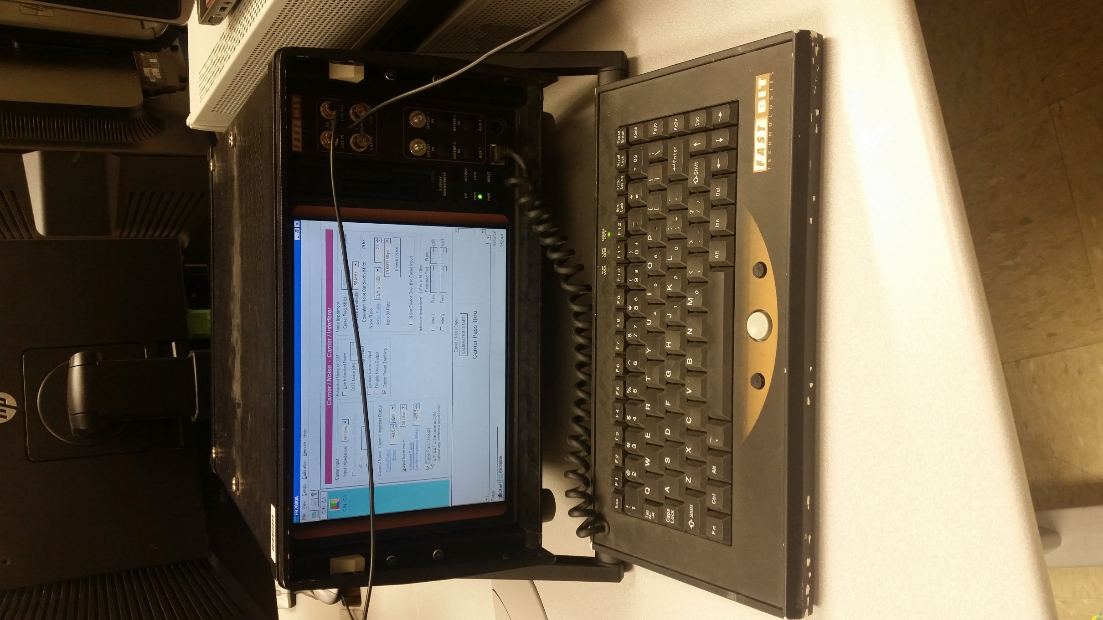

Slide 12

T/M Receiver & Demod
RF
70 MHz IF
Samples
Bits
T/M Receiver
ADC
Host CPU
Host CPU
FPGA
FPGA
BERT
K40c GPU
K20c GPU
K20c GPU
Rack Mounted Server
Rack Mount Case

Slide 13
SOQPSK-TG TX
Multipath
Channel
Host CPU
FPGA
Noise
Source
RF
Bits & Clk
Power Splitter
T/M Receiver
Preamble Scrubber
BERT
Bits & Clk
Bits & Clk
ADC
Host CPU
Host CPU
FPGA
FPGA
Samples
70 MHz IF
Spectrum
Analyzer
K40c GPU
K20c GPU
K20c GPU
Rack Mounted Server

Slide 14
Bits & Clk
Power Splitter
T/M Receiver
Preamble Scrubber
BERT
Bits & Clk
Bits & Clk
RF
ADC
Host CPU
Host CPU
FPGA
FPGA
SOQPSK-TG TX
Multipath
Channel
Noise
Source
Samples
70 MHz IF
Spectrum
Analyzer
K40c GPU
K20c GPU
K20c GPU
Rack Mounted Server

Slide 15
Configuration for static multipath tests for data aided EQ
custom
BERT
interface
BERT
custom
clk/data
power
splitter
T/M RX
EQ +
demod
clk/data
channel 1
IF
clk/data
<10 mW @ 10.3125 Mbit/s
(vp = 27)
clk/data
preamble finder + phase ambiguity
clk/data
SOQPSK
TX
multipath
channel
noise
source
channel 1
clk/data
clk/data
QSX-RDMS
-RM2-Q-1100-X2
Spirint SR 5500
Wireless Channel Emulator
Fast Bit
FB0008
QSX VMR 110 00S 20 2D VP iNET
S/N 7452
Spec. An.
Agilent E4404B
ESA-E Series Spectrum Analyzer
Mini-circuits
ZB4PD-462W-S+

